Slide 1
Hang the Man
The Hangman Game
Team Members
SRN
Mahi J Doshi
Manisha Balaji
Lisha Chowdary
Nidhi Begane Sreesha
PES2UG25AM151
PES2UG25CS293
PES2UG25AM144
PES2UG25CS332
TEAM NO : B15

Slide 2
Problem Statement
The objective of this project is to design and implement a fully functional Hangman game in Python by dividing the program into four independent modules.
  The game should allow users to guess a hidden word by selecting letters, while keeping track of wrong guesses and remaining chances.
  The game should support multiple word categories (such as fruits, animals, and countries), and each category should allow difficulty levels (easy, medium, hard).
  If the user selects a random category, the game should automatically choose one and display it.

Slide 3
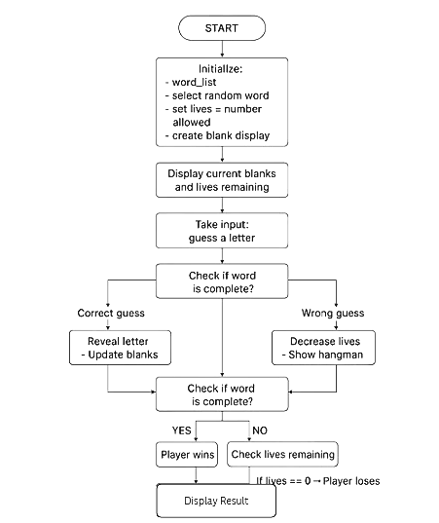
Block
Diagram

Slide 4
Contribution
of
Members
Lisha Chowdary - main.py
Mahi J Doshi - logic.py
Handled the central game controller, bringing all other modules together.
Responsible for :
  Initializing the program
  Managing the game flow
  Connecting the UI + logic + wordlist
  Handling start/end of game
Developed the core Hangman logic.
Responsible for:
  Checking correct/incorrect guesses
  Updating the hidden word
  Tracking attempts/lives
  Determining win/loss conditions
Manisha Balaji - wordlist.py
Nidhi Begane Sreesha - ui.py
Created and structured the word dataset.
Responsible for :
  Preparing the list of words
  Ensuring a variety of difficulty levels
  Providing a clean API for retrieving random words
Built the user interface layer.
Responsible for :
  Accepting user input
  Displaying the Hangman graphics
  Showing guesses, messages, and game status
  Ensuring the game looks clean and understandable

Slide 5
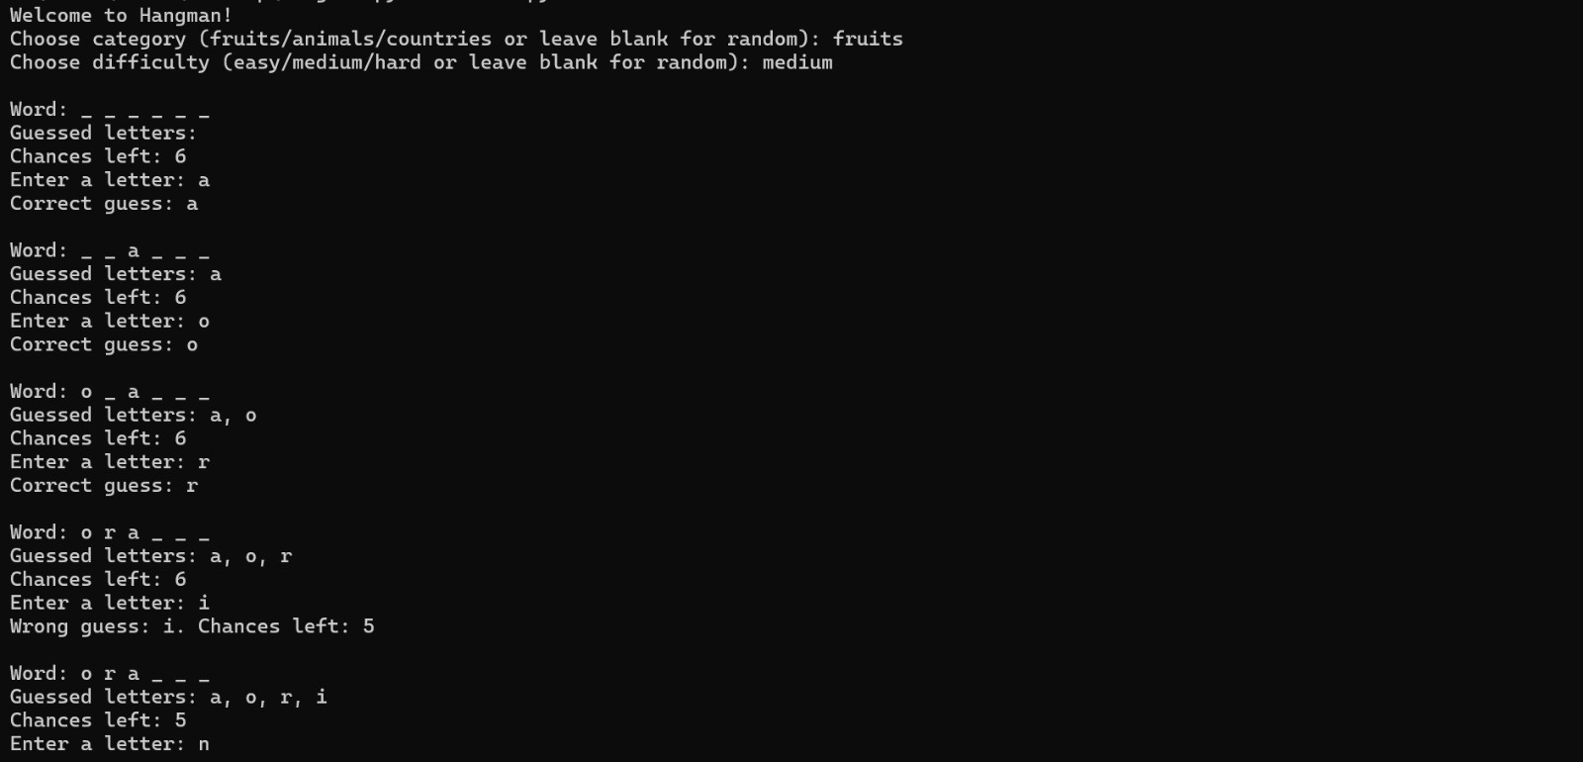
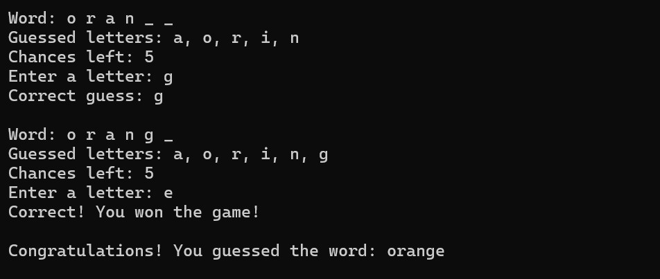
Input-Output without UI

Slide 6
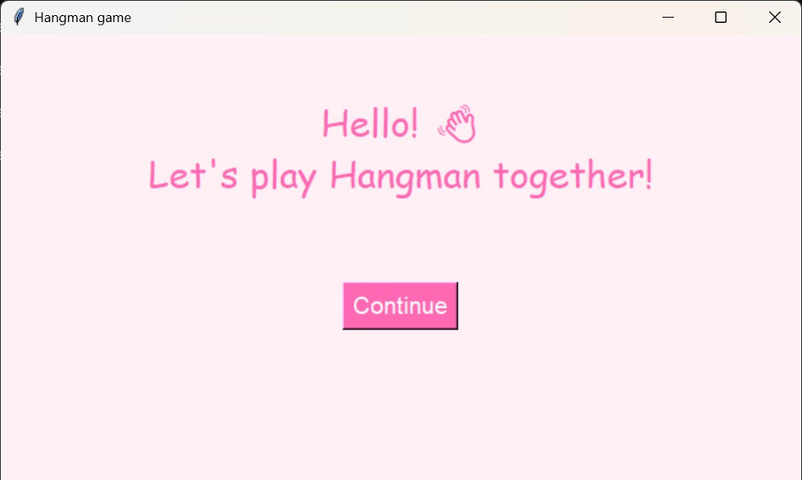
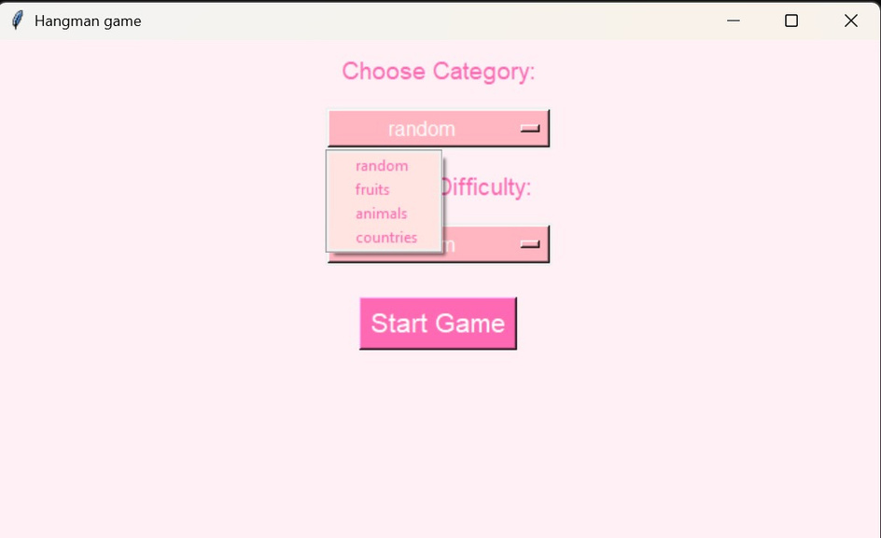
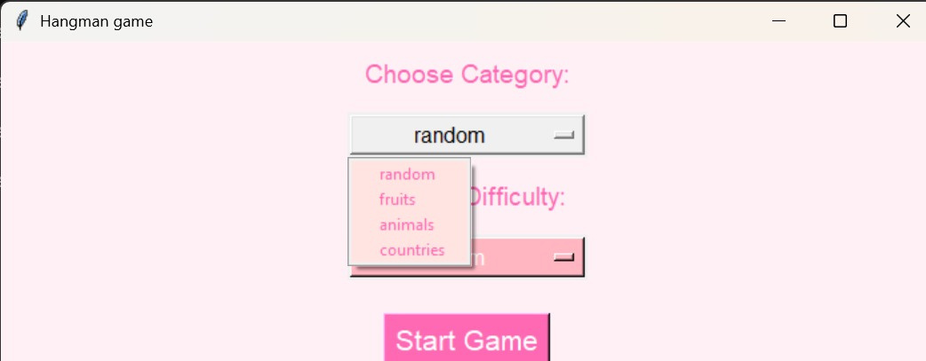
With UI

Slide 7
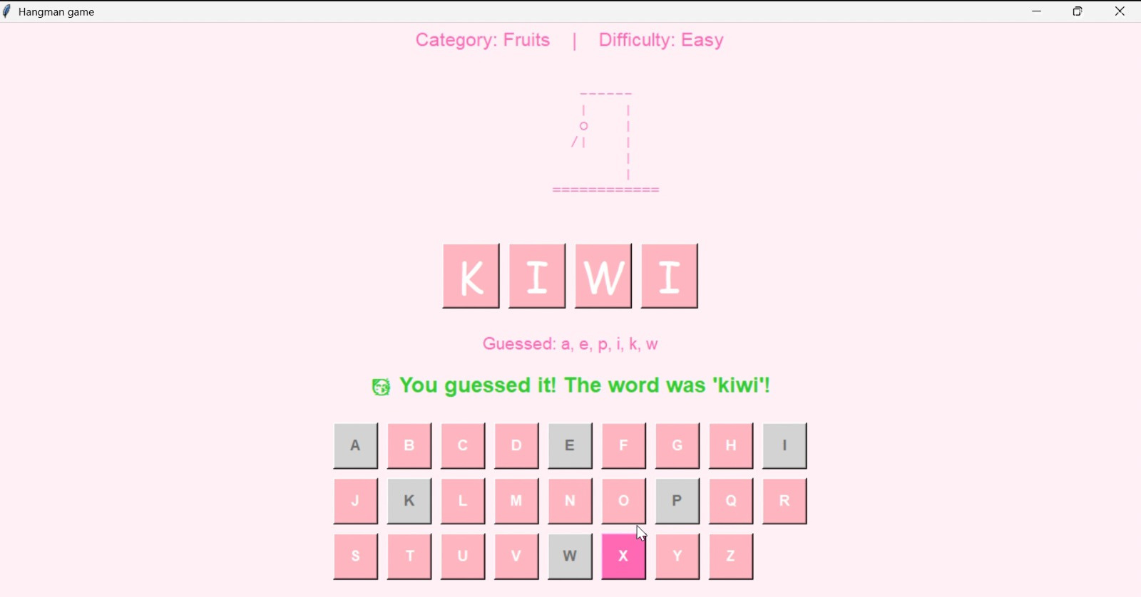
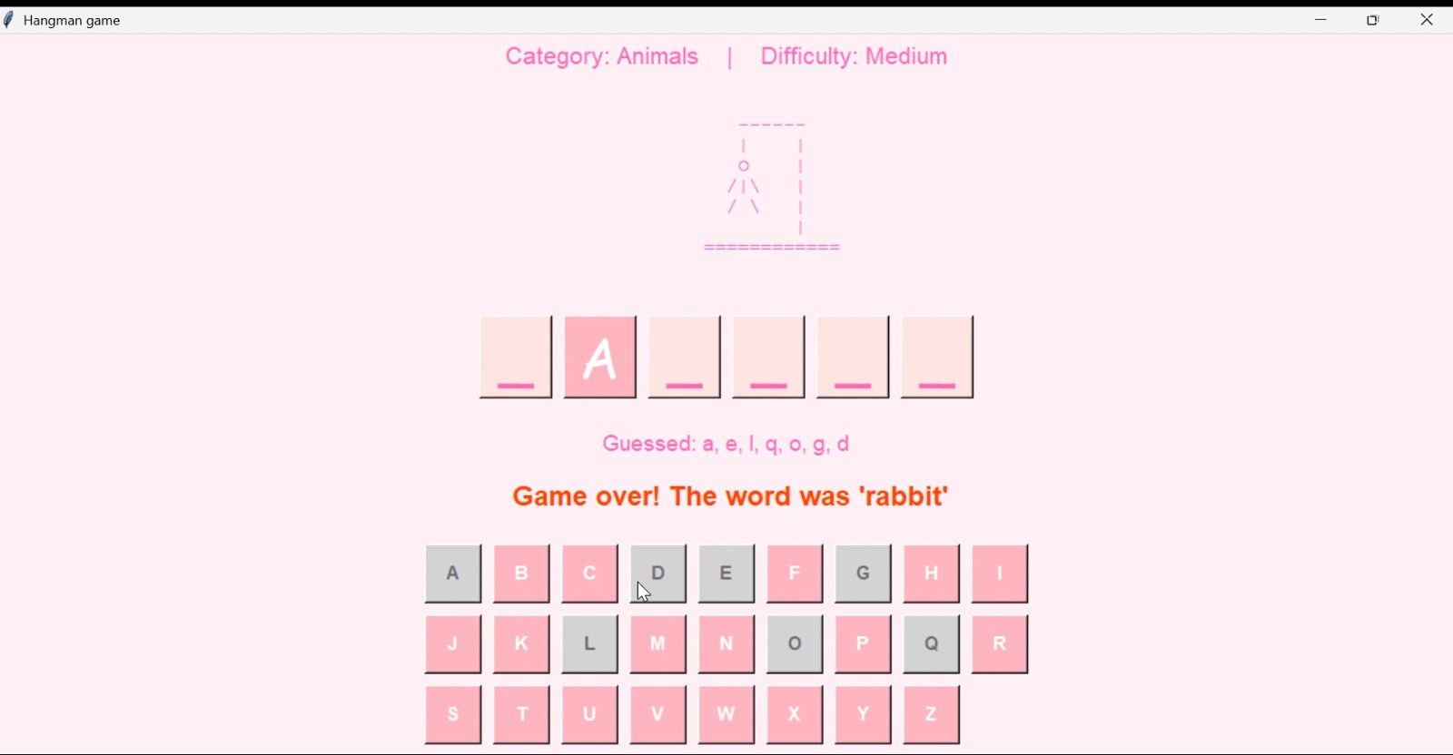
With UI

Slide 8
logic.py game logic
def guess_letter(self, letter)
letter = letter.lower()
if self.game_over:
return "Game already over."
if not letter.isalpha() or len(letter) != 1:
return "Please enter a single valid letter."
if letter in self.guessed_letters:
return f"You already guessed '{letter}'."
self.guessed_letters.append(letter)
# Correct guess
if letter in self.word:
self.correct_letters.add(letter)
if self._check_win():
self.game_over = True
self.win = True
return "Correct! You won the game!"
return f"Correct guess: {letter}"
# Wrong guess
else:
self.chances_left -= 1
if self.chances_left <= 0:
self.game_over = True
return f"Wrong! No chances left. You lost! The word was '{self.word}'."
return f"Wrong guess: {letter}. Chances left: {self.chances_left}"
def get_display_word(self):
"""Return the word with unguessed letters hidden."""
return " ".join([letter if letter in self.correct_letters else "_" for letter in self.word])

Slide 9
main.py
game
loop
from wordlist import get_random_word
from logic import HangmanGame
def main():
print("Welcome to Hangman!")
category = input("Choose category: ").strip().lower()
difficulty = input("Choose difficulty: ").strip().lower()
game = HangmanGame(
get_random_word(category if category else None,
difficulty if difficulty else None)
)
while not game.game_over:
print("\nWord:", game.get_display_word())
guess = input("Enter a letter: ").strip().lower()
print(game.guess_letter(guess))
print("\nFinal word:", game.word)

Slide 10
def hangman(stage):
if stage == 0:
print("""
------
| |
|
|
|
|
============
""")
elif stage == 1:
print("""
------
| |
O |
|
|
|
============
""")
elif stage == 2:
print("""
------
| |
O |
| |
|
|
============
""")
elif stage == 3:
print("""
------
| |
O |
/| |
|
|
============
""")
d elif stage == 4:
print("""
------
| |
O |
/|\\ |
|
|
============
""")
elif stage == 5:
print("""
------
| |
O |
/|\\ |
/ |
|
============
""")
elif stage == 6:
print("""
------
| |
O |
/|\\ |
/ \\ |
|
============
""")
word = input("Enter the word for Hangman: ").lower()
guessed = ["_"] * len(word)
wrong_guesses = 0
while wrong_guesses < 6 and "_" in guessed:
print("Word:", " ".join(guessed))
print("Wrong guesses:", wrong_guesses)
hangman(wrong_guesses)
guess = input("Guess a letter: ").lower()
if guess in word:
for i in range(len(word)):
if word[i] == guess:
guessed[i] = guess
else:
wrong_guesses += 1
ui.py
button guess

Slide 11
def filter_by_difficulty(word_list, difficulty):
if difficulty == "easy":
return [w for w in word_list if len(w) <= 5]
elif difficulty == "medium":
return [w for w in word_list if 6 <= len(w) <= 8]
elif difficulty == "hard":
return [w for w in word_list if len(w) > 8]
else:
return word_list
wordlist.py word selector
words = {
"fruits": [
"apple", "banana", "mango", "orange", "grapes", "pear", "papaya",
"pineapple", "watermelon", "melon", "kiwi", "strawberry", "cherry",
"guava", "peach", "plum", "blueberry", "blackberry", "lychee"
],
"animals": [
"tiger", "elephant", "lion", "zebra", "giraffe", "cheetah", "monkey",
"panda", "kangaroo", "leopard", "bear", "wolf", "fox", "rabbit",
"camel", "buffalo", "hippopotamus", "rhinoceros", "deer", "goat"
],
"countries": [
"india", "china", "france", "nepal", "brazil", "canada", "japan",
"germany", "italy", "russia", "spain", "mexico", "argentina",
"australia", "egypt", "turkey", "england", "portugal", "sweden",
"norway"
]
}
def get_random_word(category=None, difficulty=None):
if category in words:
word_list = words[category]
else:
word_list = words["fruits"] + words["animals"] + words["countries"]
word_list = filter_by_difficulty(word_list, difficulty)
return random.choice(word_list)

Slide 12
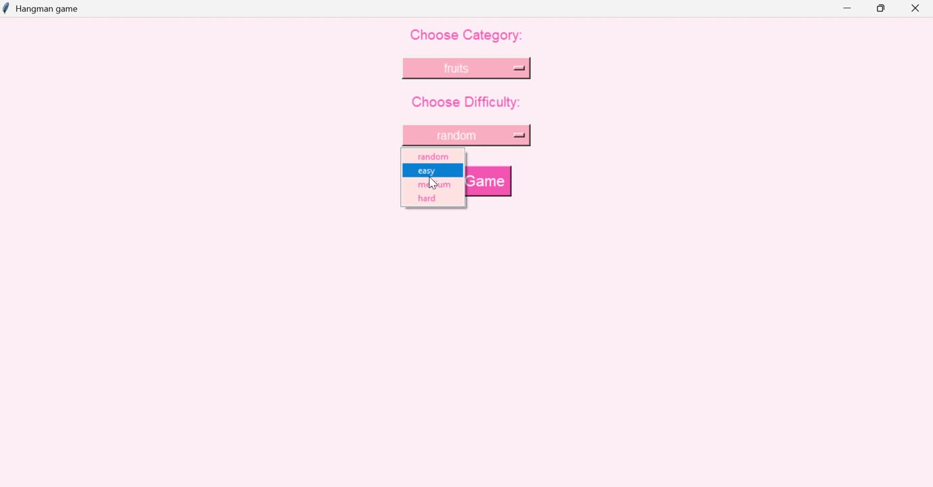

Slide 13
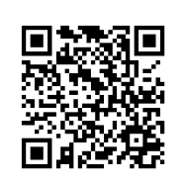
GitHub Link:
https://github.com/mahidoshi190/Hangman-Game

